Slide 1
Lecture 14:
Convolutional Neural Networks on Surfaces via Seamless Toric Covers
Jiacheng Cheng
Feb, 21, 2018
Notes:
Hello everyone. My name is Hao Su. I am a new faculty of the CSE department. This is my first lecture in UCSD. Hope that we will enjoy the quarter working together.

Slide 2


Convolutional neural networks on surfaces via seamless toric covers
1
Haggai Maron, Meirav Galun, Noam Aigerman, Miri Trope, Nadav Dym, Ersin Yumer, Vladimir G. Kim, Yaron Lipman

Slide 3
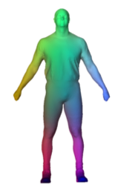
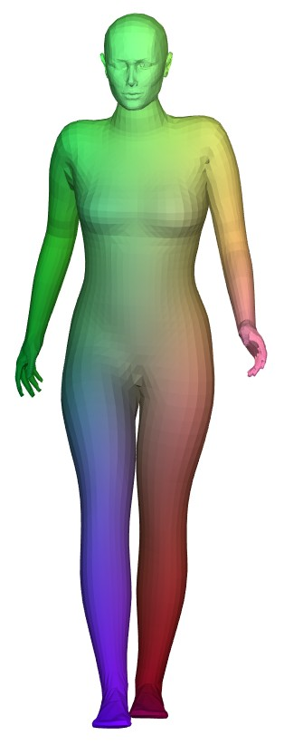
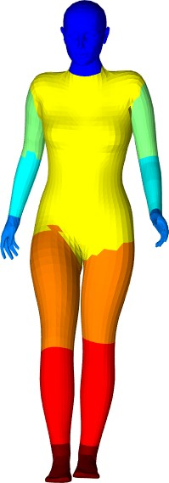
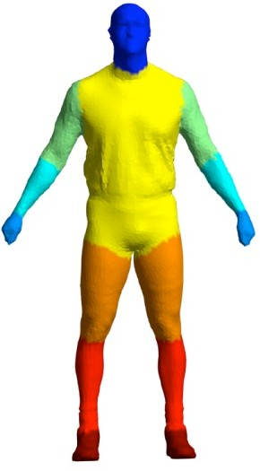
Problem statement
Easy
Hard
Notes:
The problem considered by this paper is the following. Given a set of shapes, to be specific, this work focus on sphere-like surfaces, which are frequently used in some applications such as analyizing human bodies. Given a set of shapes, we would like to learn a function on the shape. For instance, on the left, the colors on surfaces represent a simple coordinate function. However a semantic-related function, such as a semantic segmentation of the human body shown in the right, is much harder to predict.

Slide 4
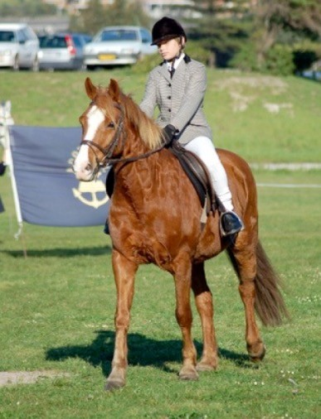

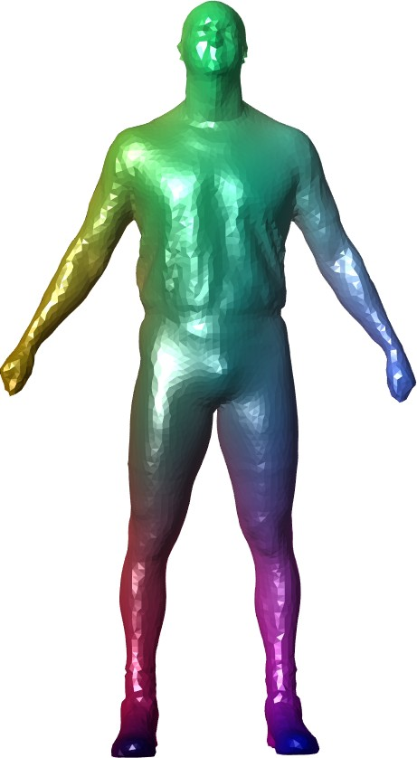
Deep Learning
Geometric Deep Learning
Notes:
The motivation of this work is to use convolutional neural networks for Geometric Deep Learning task.

Slide 5

What is required to define a CNN?
Notes:
To begin with, Revists the main blocks of a CNN. Authors claim that in order to define CNNs, we need to define the concept of movement or translation on the domain. Once the concept is clear, we are one step closer to defining CNNS on surfaces.

Slide 6
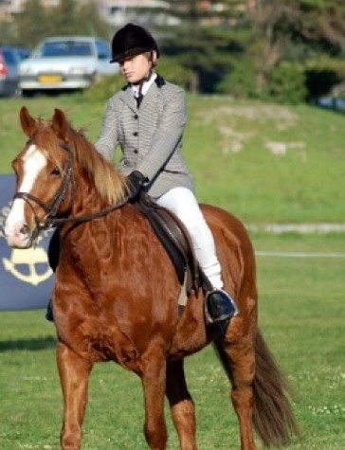
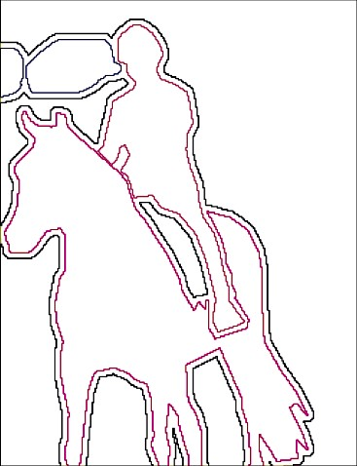
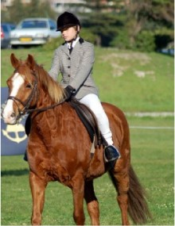
Translations
Two dimensional, commutative Isometries of R^2
Convolution
Linear
Translation invariant
Pooling
Non-linear (max)
Sub-translation invariant
Notes:
Revisit the case of regular images defined on R2, The translation on image are just regular shifts in the x and y-coordinaties. This notion of translation helps us to define two main building blocks of CNNs. The first is convolution, which is a linear and translation invariant operator. The translation invariance is extremely important for CNNs since it makes sure that the same image feature will be treated in exactly the same way in every possible position in a image.
The second operation is the pooling operator that aggregate information for multiple neighbor pixels. These pixels are also defined according to the translations, like convolutions.

Slide 7
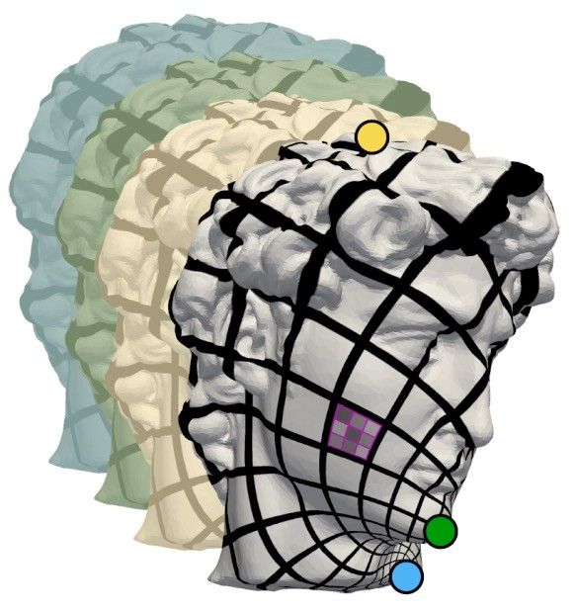
Defining CNNs on surfaces
Notes:
So we saw that for images, we can first define translation and use it to define convolutions and pooling operators. This will be the motivation for defining CNNs on surfaces

Slide 8
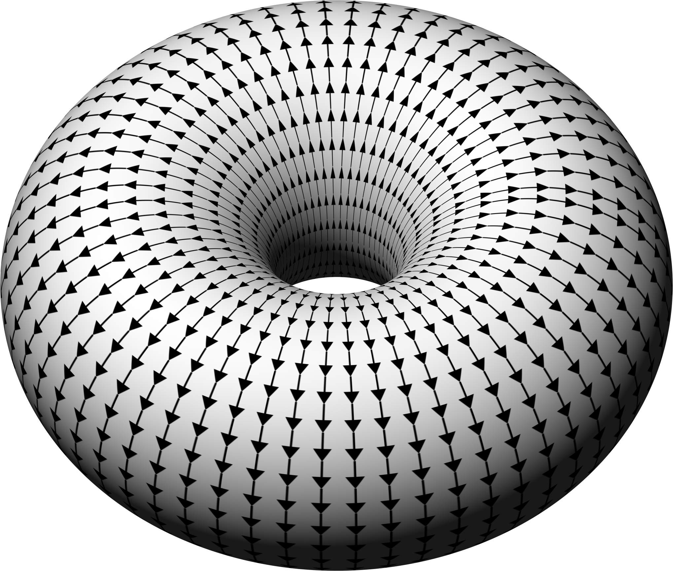

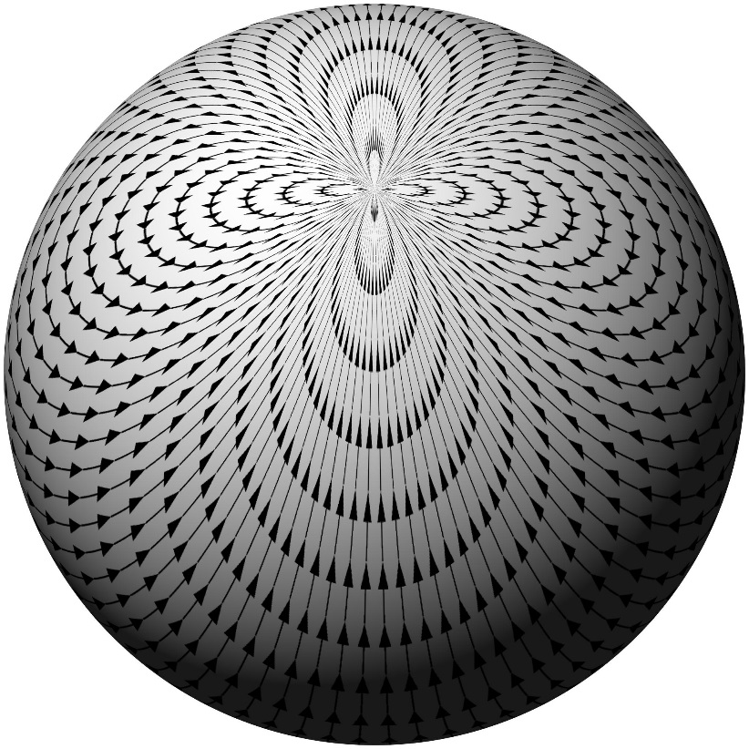
Translations on surfaces?
Translation on surface ≝ locally Euclidean translation
Flow along non-vanishing vector fields
Notes:
We need to define the concept of a translation on a surface. In this work, the transformation is defined to be the locally Euclidean translation. That is, a flow along a nonvanishing vector field.
An question we need to ask is which surfaces admit such non-vanishing vector fields.

Slide 9
Flat torus !
Translations “modulo 1”
Full translation invariance on the flat torus
!
Notes:
On right side, we can see a nonvanishing vector field on the torus. And on the left side, we can see a flat torus.

Slide 10
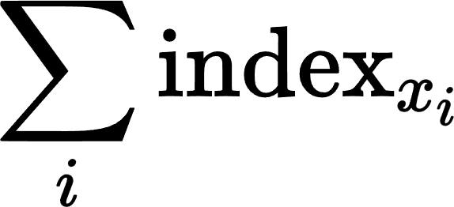

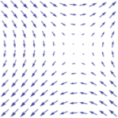
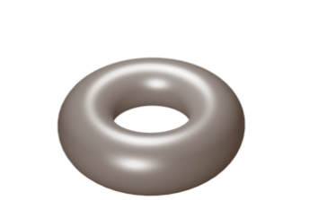
Only the torus!
Index
of vector field
Euler characteristic
Poincaré-Hopf: For a compact orientable surface
Index – a measure of the complexity near a vanishing point
Non-vanishing vector field implies genus 1 - torus
Notes:
Whats more, there are some theoretical results implying that the only closed orientable surfaces with non-vanishing vector fields is the torus.

Slide 11

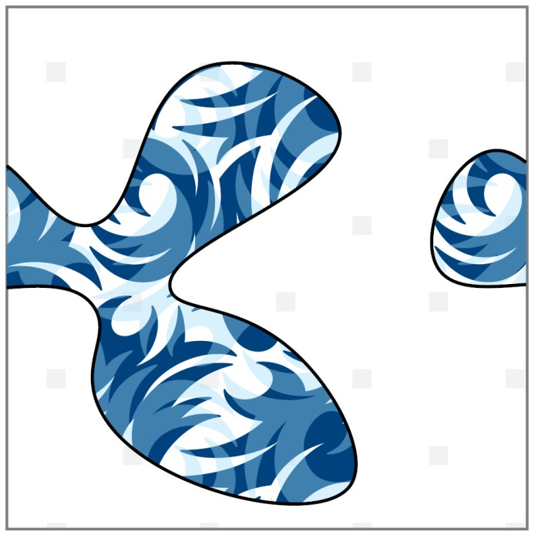
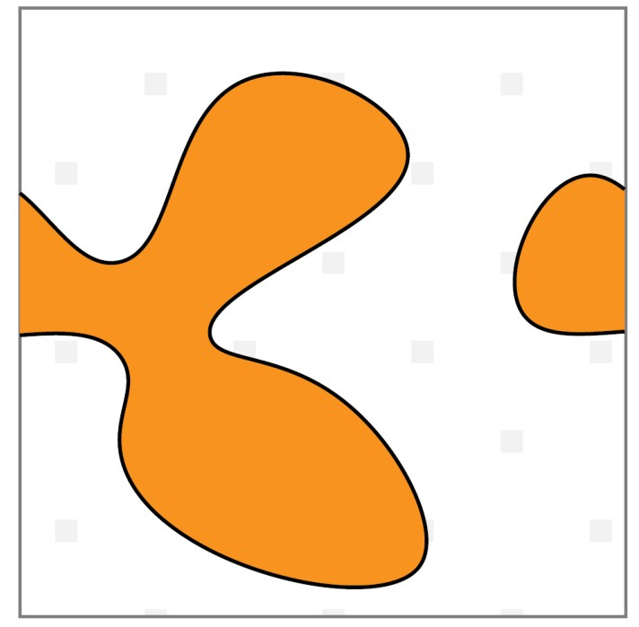
15
CNN on flat torus
Cyclic padding
Notes:
Further, The authors show that the standard CNNs can be easily used to perform deep learning on torus.

Slide 12
Recap
16
CNN is well-defined over flat-torus
Roadblocks for CNN on sphere-type surfaces
Topological: No locally Euclidean translations on spheres
Geometrical: The flat torus is flat and our surface is not
Notes:
So lets recap, we want to define CNN on surfaces and CNN is well-defined over flat torus. But there are still two main issues needs solving. The first one is that there are no locally Euclidean translations on sphere-like surfaces. The second one is that The torus is flat and our surface is not

Slide 13
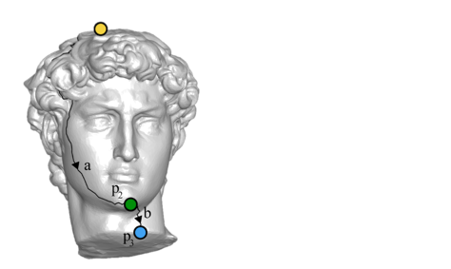
Solution: Map the surface to a flat torus
17
Notes:
The solution proposed by this work is to map the surface to a flat torus.

Slide 14
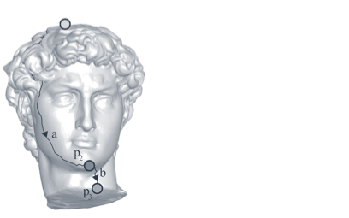
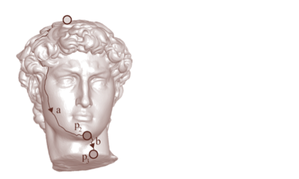
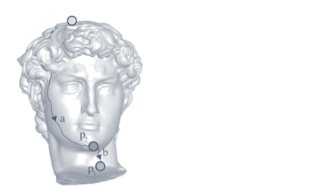
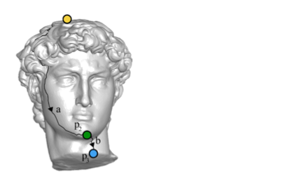
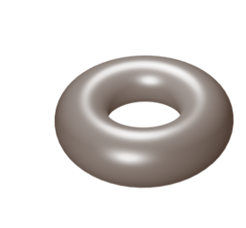
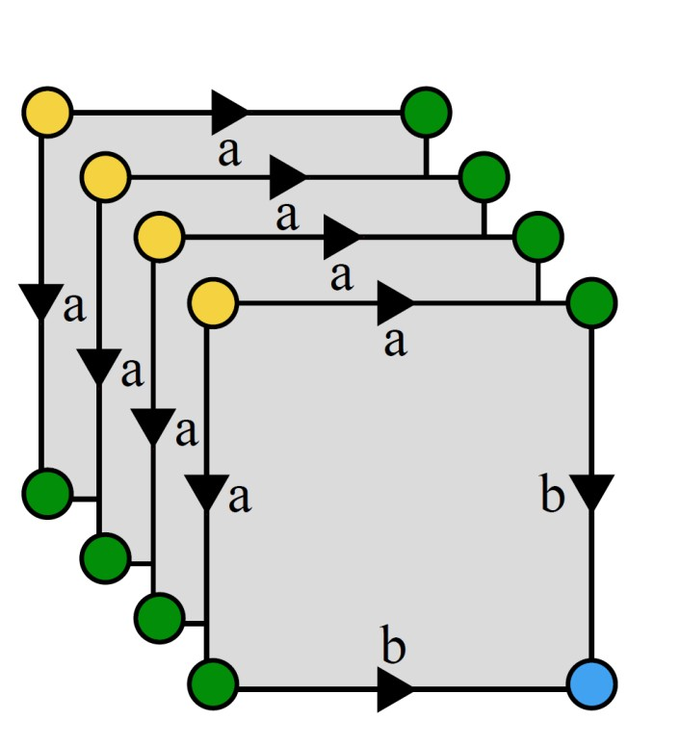
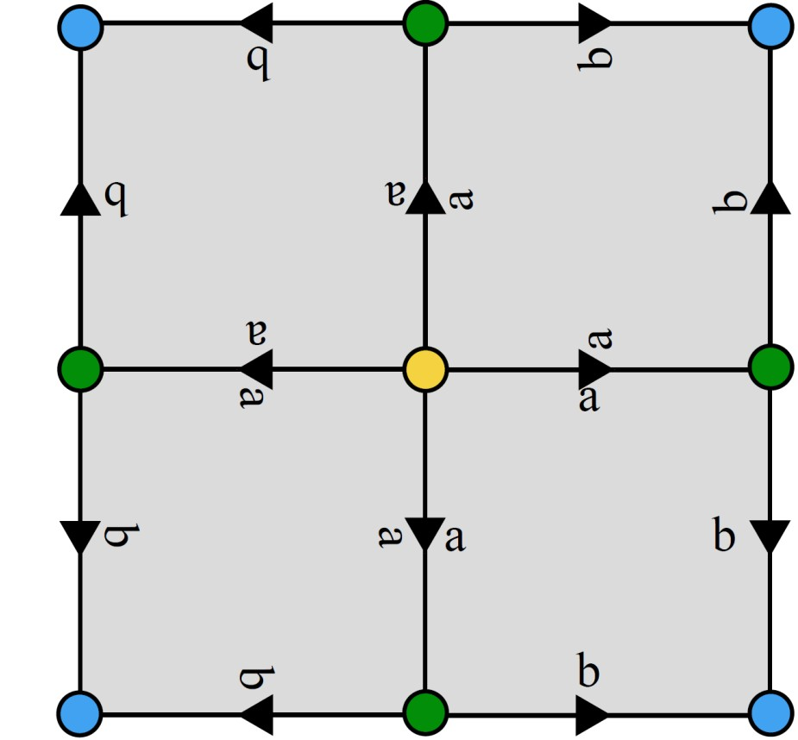

Torus 4-cover
≅
Notes:
Lets see how to do it. For a sphere-type surfaces, on which we cannot define suitable vector field. What we are going to do is topologically build the torus from four copies of the surface. For any triplet of points on the surface, We take the four copies and cut them into a disk topology ( shown as the four squares.) by gluing together the edges of those four squares according to the color of the vertex. Then we get a new surface with the torus topology. Mathematically, we can say that the torus is a covering space for the surface.

Slide 15
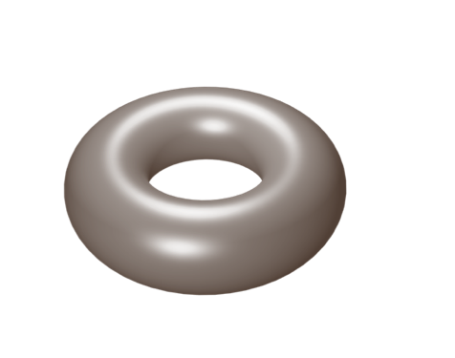
19
Mapping the Torus to the flat Torus
!
Aigerman and Lipman, 2015
Notes:
After we got the torus, the author show there is an efficient algorithm proposed by another paper to map a tours to a flat torus conformally.

Slide 16
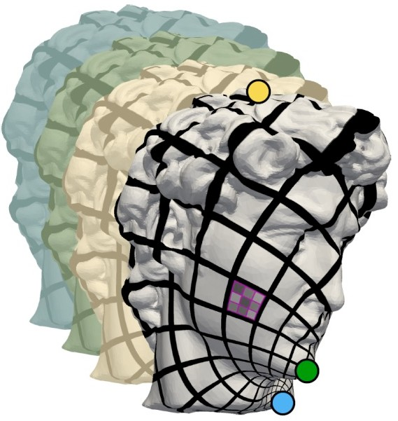
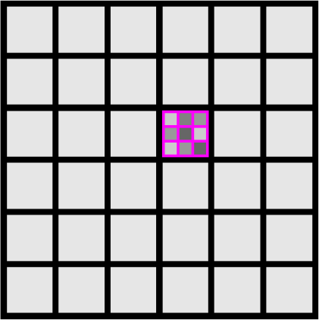
The pull back translation
!
Notes:
After obtaining the flat torus representation, we can define translations on the surface as the pull back translations on the flat torus. In other words, in order to move on the surface, we can map the point to a flat torus and take a regular step there and map it back to the surface.

Slide 17
Pull-back
22
Translations: pull-back Euclidean translations
Two dimensional, commutative
Conformal maps
!
Pull-back convolution
Linear
Theorem: Translation invariance
Pull-back pooling
Non-linear (max)
Sub-translation invariant
Notes:
We define the pullback convolution and pullback pooling. We map the surface to the torus, do the regular convolutions and poolings there, and map the result back to the surface. Defining the convolution in this way seems reasonable, since it is invariant to the pullback translation. Actually this is a theorem proved in the paper.

Slide 18


New layers
24
cyclic padding
projection
Notes:
, in order to make any cnn can work in these settings, the author propose two new type of layers. The first type is the cyclic padding layer that makes sure we work on the torus. The second layer is a projection layer. Remember that our function is defined on four copies on the surface and we need only one. Given four corresponding points on four copies, the projection layer returns their maximal value.

Slide 19

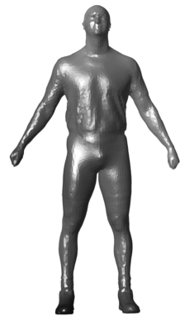
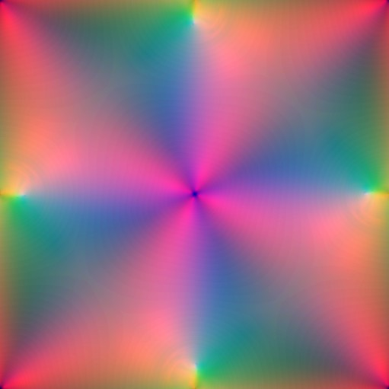
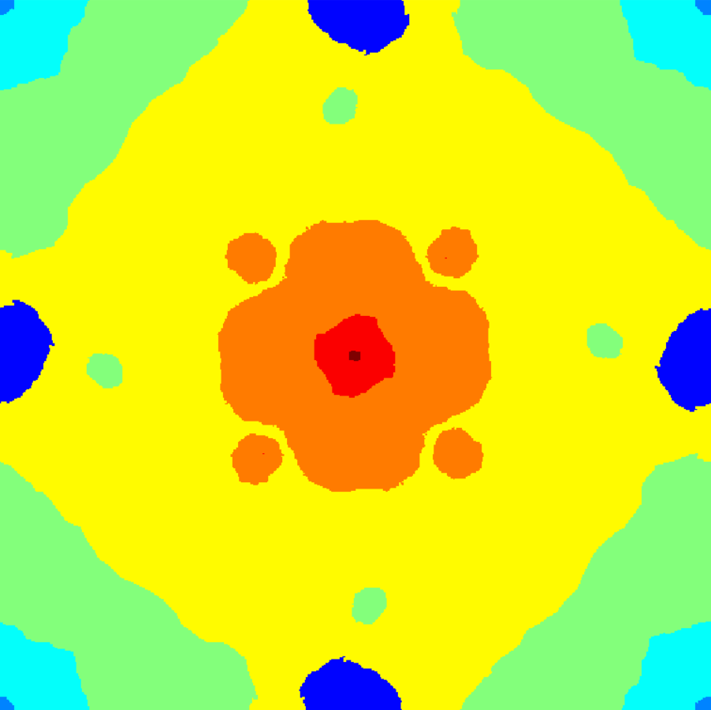


Data generation
Input image
Labels
Notes:
The procedure of data generation is as follows. For each surface, we select K triplets of points. Each of these triplets gives us a new mapping to the flat torus. Then it can be used as regular images.

Slide 20
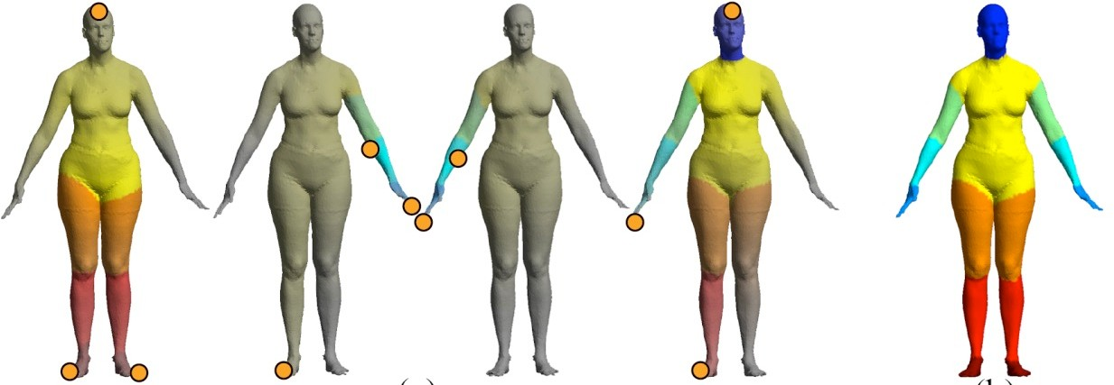
Test phase
26
Aggregation from different triplets
“Magnifying glass”
Scale factor as weights
+ + +
=
Notes:
For test phase, prediction will be made for multiple triplets for each mesh. Each
triplet serves as a magnifying glass for some local or global part of the
surface. A weighted sum of label probabilities will be the output.

Slide 21
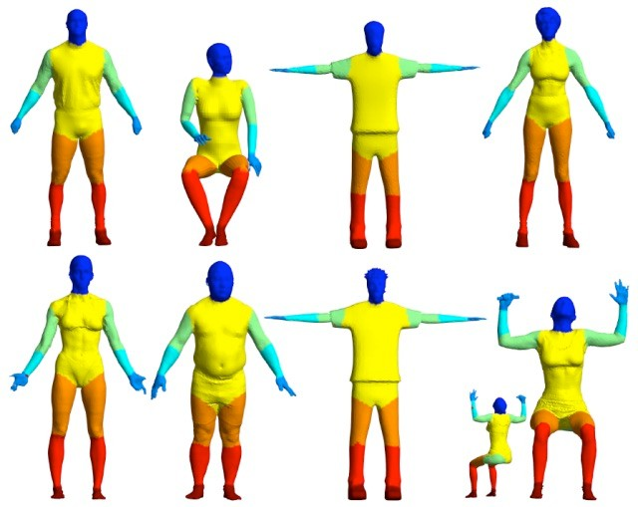
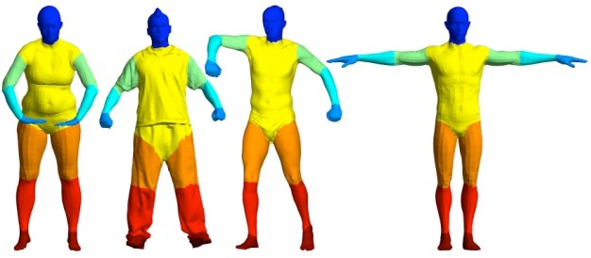
Human body segmentation
27
Train: 370 models
FAUST, MIT, SCAPE, ADOBE
Test: 18 models
SHREC07
Notes:
One application of this work is the semantic segmentation of the human body. That is to label each vertex on the shape with one of eight possible labels, such as head, hand, and so on.

Slide 22
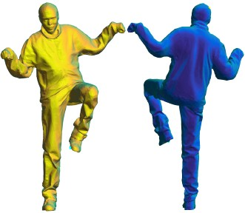

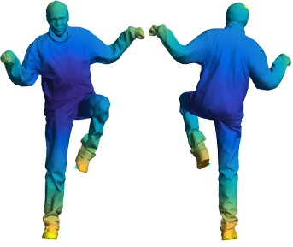
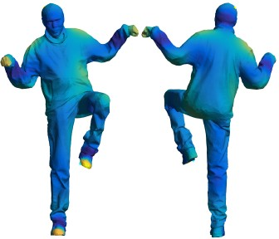
Easy functions
Normals
Raw
Average geodesic distance
Wave kernel signature
Complex
Notes:
There are many types of features we can use, from very raw features such as normal functions to more complex feature such as the wave kernel signature.

Slide 23
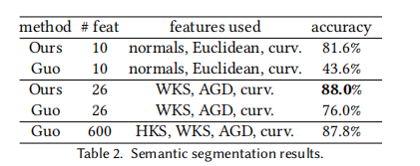
Human body segmentation
Train: 370 models
FAUST, MIT, SCAPE, ADOBE
Test: 18 models
SHREC07
Notes:
Evaluations are conducted on two sets of features. The first one is raw feature set, it consists of Euclidean coordinates, the normal and curvature functions. It is shown that this work dramatically outperforms the competitor. The second set of feature is less raw, but still low-dimensional. They includes wave kernel signature, average geodesic distance and curvature features. It shown that this work still performs significantly better. Even if the competitor use more high-dimensional features, it is still outperformed by this work. A conclusion is that the proposed method relies much less on handcrafted feature and is able to learn semantic information from raw features. This is probably due to the fact that it can exploit the full context of the shape.

Slide 24
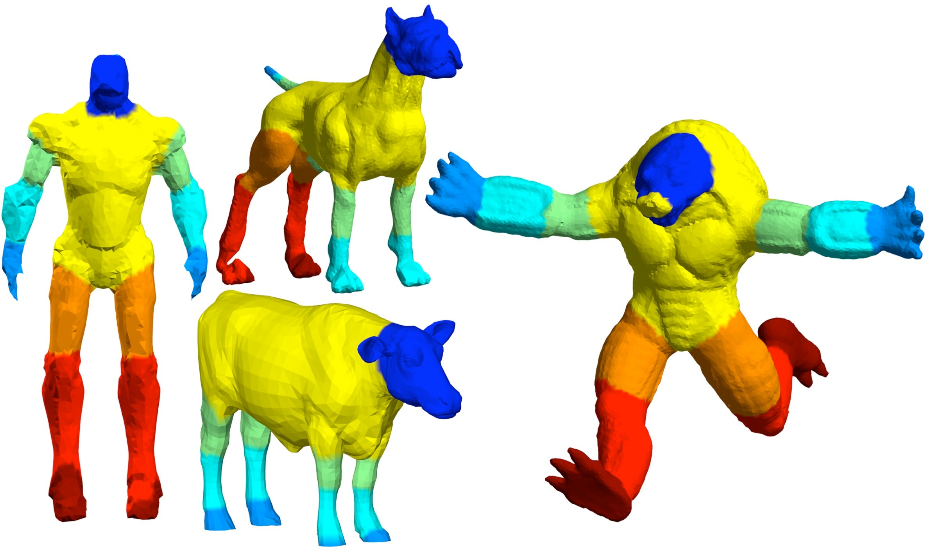
CNN applied to other data
Notes:
The author also apply this method on other similar but non-human shapes. In spite of this difference, maybe we can call it a domain transfer, the method is still able to get meaningful results.

Slide 25
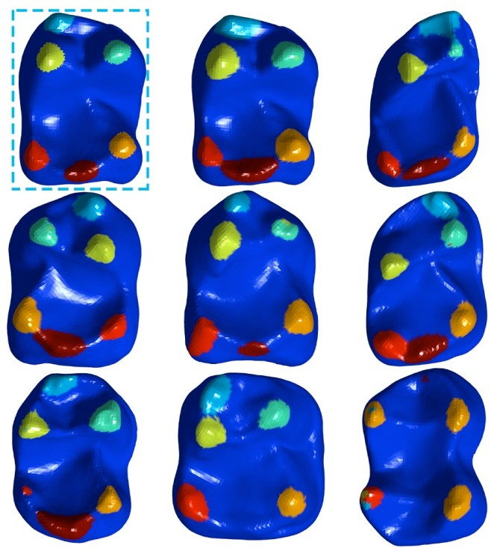
Biological landmarks detection
Train: 73 teeth from BOYER
Only curvature and scale factor
Test: 8 teeth from BOYER
Notes:
The second application is landmark detection from anatomic surfaces. There are six teeth selected as landmarks by experts. In this application only raw features are used, they are curvature and scale factor. The top left figure is the groundtruth and the rest are results by the proposed method.

Slide 26
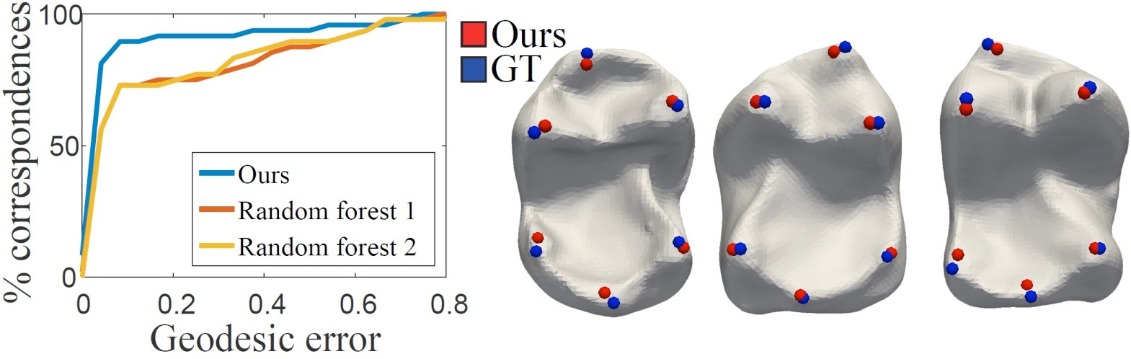
Biological landmarks
32
Notes:
The comparison is performed between the proposed method and random forest classifier which use some strong features. The graph shows that the proposed method outperform the random forrest classifier although it uses less features.

Slide 27
Conclusion
35
CNN of sphere-type surfaces
We defined a meaningful convolution on surfaces
Learns from raw features
Reusing CNN software for images
Limitations and future work
Scope: Only sphere type surfaces
No canonical choice for triplets (and convolutions)
Learn aggregation operator
Notes:
In coclusion, this work defines convolutional neural network on sphere type surfaces by defining a meaningful convolution. It shown that the method is able to lear from raw features and it Is easy to use any CNN architecture.
The main limitation of this works are the following, the first is that it only work on sphere type surfaces. Another limitation is that there is no canonical convolution on the surface since it depends on the choice of triplets. In this work it is done by sampling some triplets and then averaging the results of different triplets. A possible future work idea is to learn a aggregation operator.

